Slide 1
Welcome to the AGM
Important Notes
Fire exits are behind you. If there is a fire alarm security will direct you.
Toilets are by the entrance. You can use those marked for staff.
If you speak, please announce your name for the minutes.
We have to close the meeting at 9:50 pm and be off the premises by 10pm so be brief,
This is a boarding school and girls are sleeping in adjacent buildings. Please leave the grounds quietly.

Slide 2
WELCOME
Annual General Meeting
Coombe Wood LTC
6 March 2025, 7.30pm.

Slide 3
Agenda and Resolutions
The President to read the notice convening the meeting.
To approve the minutes of the 2024 Annual General Meeting.
To receive the President’s report.
To receive the Honorary Treasurer’s report on the financial position of the Club.
To adopt the accounts of the Club for the year ended 31 December 2024.
To approve the subscriptions and fees for the new membership year.
To approve the election of John Gordon as the Club’s Auditor for the coming year.
To approve the granting of Honorary Life memberships.
To report on converting the club to a company limited by guarantee and updating the club rules.
To consider resolutions proposed by members.
To approve the election of the President, Chair, Honorary Secretary, Honorary Treasurer, and other members of the Committee.
To seek approval for proposed 2025 expenditure.
Any other business

Slide 4
President’s Address
Mike Bourne
President

Slide 5
Resolution
To approve the minutes of the 2024 Annual General Meeting.

Slide 6
Honorary Treasurer’s report
Paul Baxter
Honorary Treasurer

Slide 7
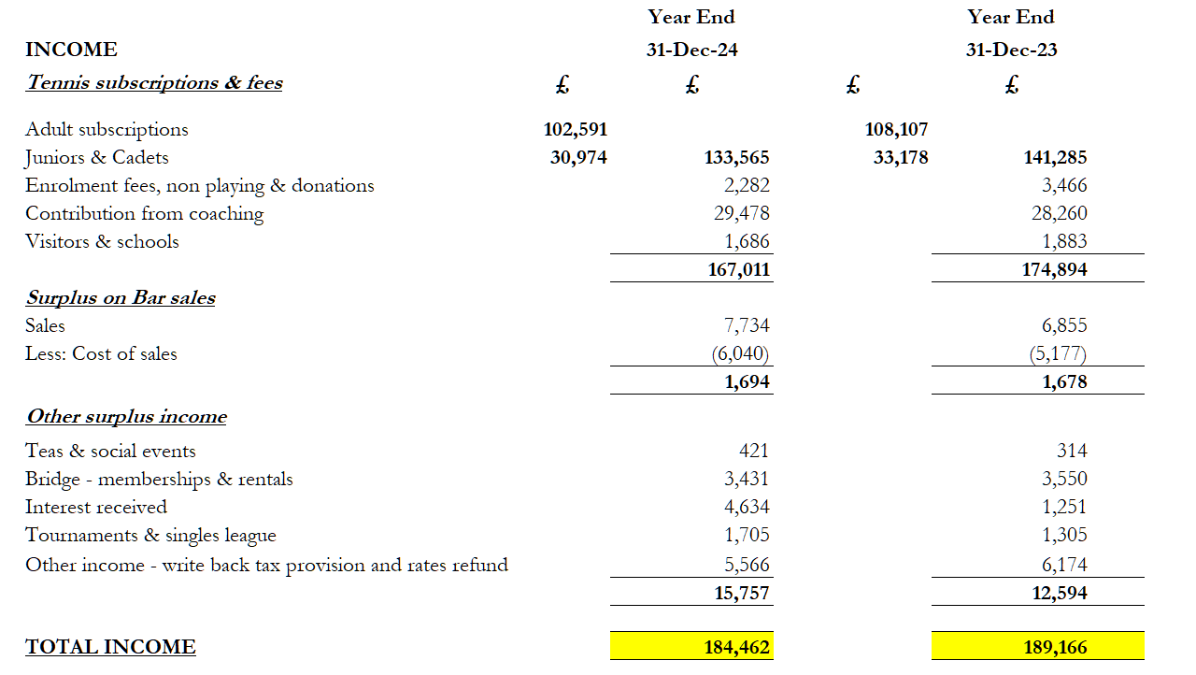
Accounts for the year ended 31 December 2024
- Income

Slide 8
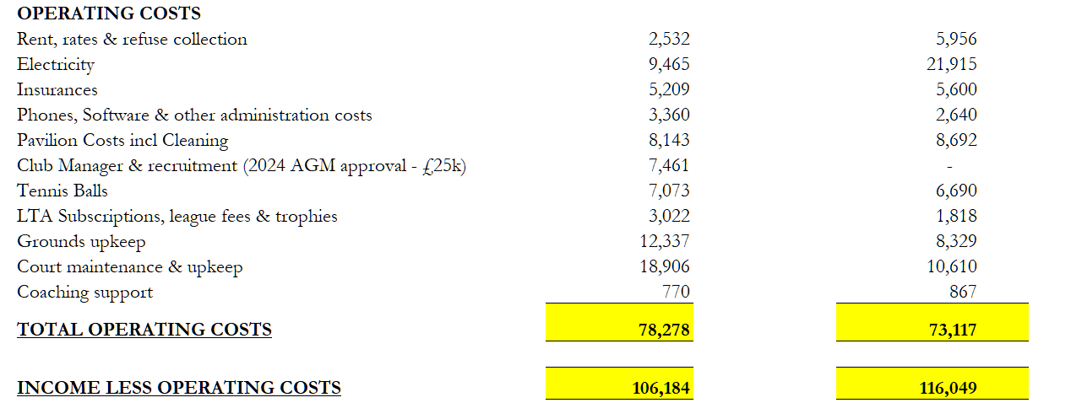
Accounts for the year ended 31 December 2024
- Expenditure

Slide 9
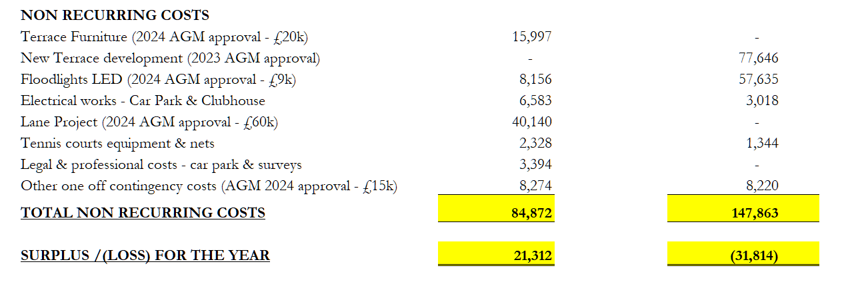
Accounts for the year ended 31 December 2024
- Non-recurring costs & Surplus for the year

Slide 10
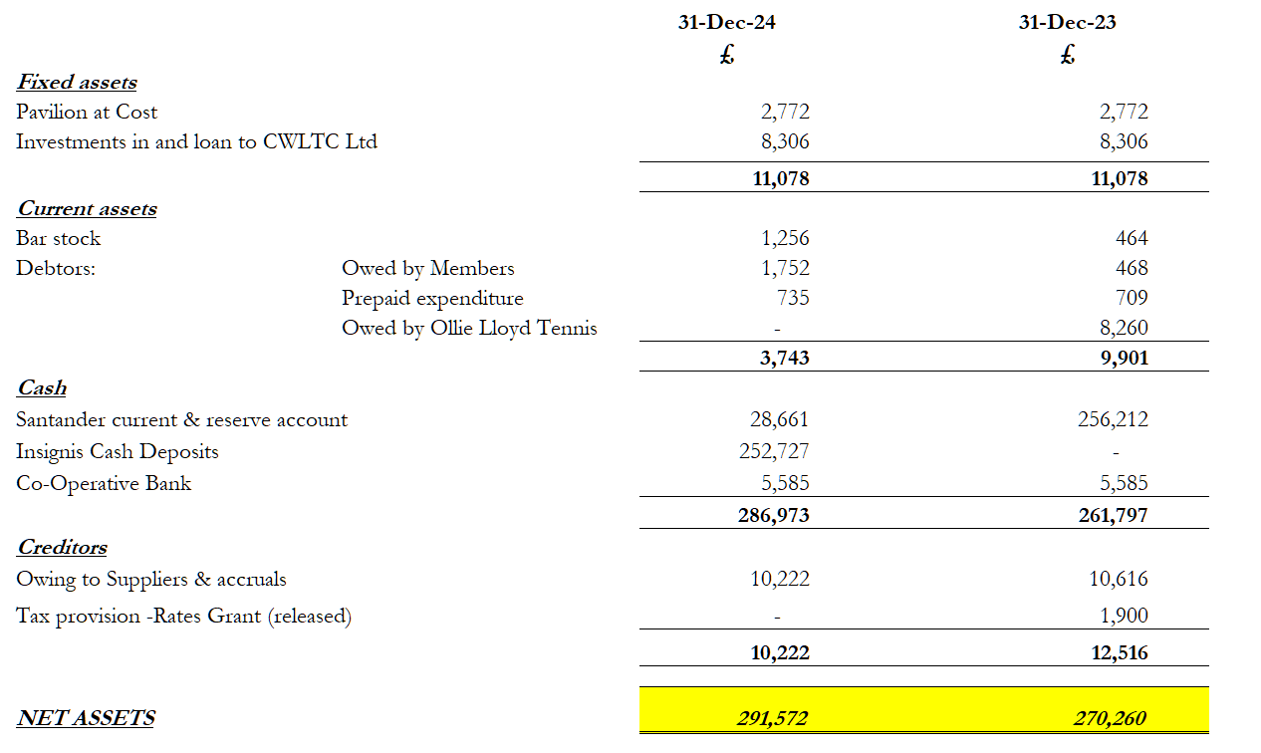
Accounts for the year ended 31 December 2024
- Assets

Slide 11
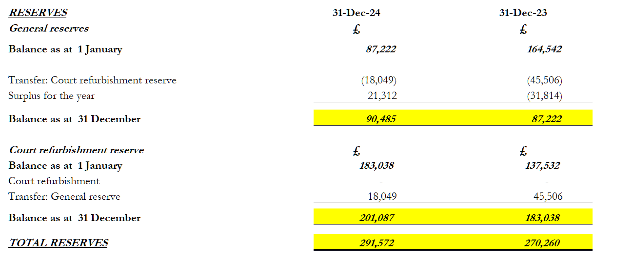
Accounts for the year ended 31 December 2024
- Reserves

Slide 12
Resolution
To adopt the accounts of the Club for the year ended
31 December 2024.

Slide 13
Resolution
To approve £110,000 to cover club running costs

Slide 14
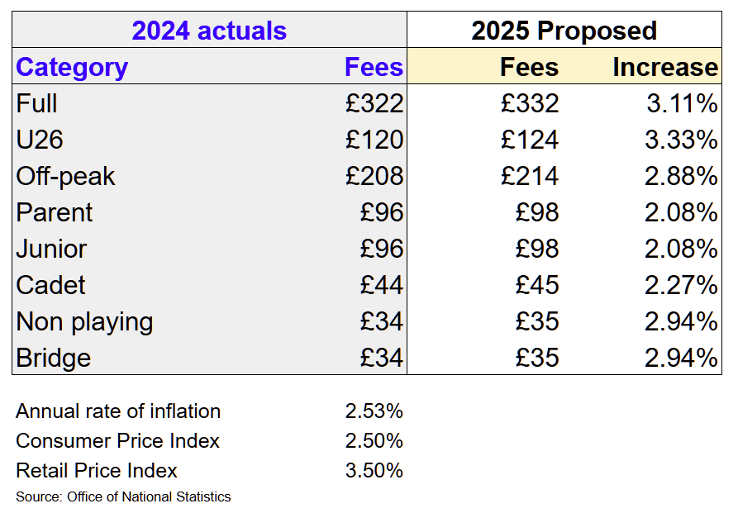
Subscriptions: 1 April 2025 to 31 March 2026

Slide 15
Resolution
To approve the subscriptions and fees for the new membership year.

Slide 16
Resolution
To approve the election of John Gordon as the Club’s Auditor for the coming year.

Slide 17
Resolution
To approve the granting of Honorary Life memberships.
For 40 years of continuous membership:
Edith Stefan
For long term committee service:
Chris Lewis
Nandini Narayanan

Slide 18
Report
Converting the club to a company limited by guarantee and updating the club rules
Rob Gale
Ex Honorary Secretary

Slide 19
Background – Reasons for Change
The club has no formal legal structure – it is an Unincorporated Association
The club rules are out of date or are not being followed
LTA guidance:
In recent years the club has grown significantly
  Membership numbers have increased to close to 1,000 across all categories
  Income has grown significantly
We have multiple supplier contracts
Need to clarify and tidy-up ownership of the club’s property/assets
  Currently held with Trustees according to the Club Rules.
An unincorporated association is suitable for smaller or informal clubs looking for a simple way to structure themselves.……..For example, they would NOT employ staff, own significant assets or enter into major contracts.
Without a legal entity in place, these contracts must be entered into in the name of individual committee members.

Slide 20
Legal structure and Club Rules proposals
Legal Structure:
Convert to a Company Limited by Guarantee
  Club and assets owned by members
  Run on not-for-profit basis
Club Rules
Rules will be updated in the Articles of Association for the new company
Committee/Board Structure
Club currently managed by Committee of 15-20 members
Two-tier Management/Main Committee results in confusion
Proposed Board of Directors of 5-10 members, with max tenure rules

Slide 21
Progress to date
Progress has been slow due to competing priorities placed on the committee
Well advanced draft Articles of Association for newco has been prepared:
  Currently with external lawyers (Brabners) for review
  Key provisions based on detailed review with the Committee review in Feb 2024
Initial tax advice obtained to ensure no CGT implications
Initial draft of new Membership Terms & Conditions which will be incorporated in new Rules has been prepared
Detailed mapping of current rules to new Articles performed

Slide 22
Current and New Management Structure
Club President
Club President?
Board
Chair
Hon Secretary
Treasurer
Match Secretary
Grounds Secretary
Membership Secretary
Social Secretary
Welfare Officer
+ 1 or 2 Former Officers
Management Team
Chair
Hon Secretary
Treasurer
Match Secretary
Grounds Secretary
Membership Secretary
Social Secretary
Welfare Officer
Other committee members
Currently 9 people
Sub committees
e.g. Coaching, Social, others as needed
Sub committees
e.g. Coaching, Social, others as needed

Slide 23
Legal structure and Club Rules - Next Steps
Review proposed rule changes and Article drafting proposals with new committee
Consult with members on the detailed proposals – 16 weeks minimum
Incorporate newco, prepare formal documents (Articles etc.) for approval at an Extraordinary General Meeting
EGM to approve appointment of first Directors, and the transfer of the club’s assets to the new company

Slide 24
Legal structure and Club Rules
Questions

Slide 25
Members’ Resolutions
To consider resolutions proposed by members

Slide 26
Resolution 1.1
Voting on Committee Members
a) Candidates to be voted on individually
b) All committee members to be elected by majority vote
c) Candidate profiles to be distributed
d) Voting by secret ballot
All the above has been implemented for this AGM

Slide 27
Resolution 1.2
Terms of Office
All committee members shall be re-elected every two years.
No committee member shall serve more than two consecutive terms (four years in total) in the same position.
After serving two consecutive terms, a hiatus of two years must be observed before they can be re-elected to the same position on the committee.

Slide 28
Resolution 1.3
Consideration of Transition to NewCo:
All articles and procedures proposed to facilitate this transition must be made available to all members well in advance of the transition to allow sufficient time for feedback and to incorporate any changes.
Minimum 16-week review period
Transition to be discussed and agreed at the next AGM
Clarity about contracts

Slide 29
Resolution 2
Viacheslav Sigel to speak about his experience being a member of our club, a volunteer and a member who was paid to do a variety of jobs for our club.

Slide 30
Resolution 3
Development and implementation of safe and transparent voting system.
All significant projects should be halted until the new voting system is in place.
All such big changes to be halted until new voting system is in place.

Slide 31
Resolution 4
All expenditure on large, non-tennis-related expenses be halted. Instead, funds should be reserved for tennis-related projects, such as all-weather covers for the existing courts.
The proposed replacement of clubhouse furniture, currently estimated to cost £7000, should be halted.
Any expenditure exceeding £2,000 (unless part of an existing maintenance contract) must be approved by a majority of members, either at an AGM or via a transparent online voting platform.

Slide 32
Election of Club Officers
Candidate for President
Michael Bourne
Vote For or Against on ballot paper 1

Slide 33
Election of Club Officers
Candidates for Honorary Secretary
Richard Senger
Donato Calviello
Vote for 1 of the above candidates

Slide 34

COOMBE WOOD LTC
Success in Numbers
£190k+ Income p.a.
£140k → £300k Coaching Revenue
£280k+ Cash Reserves
930+ members
37 Teams

Slide 35

I.
Club’s Social Atmosphere

Slide 36
II. Communication & Member Engagement

Slide 37
III.
Tennis Facilities

Slide 38
IV.
Stability & Future-Proofing

Slide 39
THANK YOU

Slide 40
Election of Club Officers
Candidates for Honorary Secretary
Richard Senger
Donato Calviello
Vote for 1 of the above candidates

Slide 41
Election of Club Officers
Candidates for Honorary Treasurer
Paul Baxter
Viacheslav Sigel
Vote for 1 of the above candidates

Slide 42
Election of Club Officers
Candidates for Chair
Matt Pickin
Armand Shaverdian
Vote for 1 of the above candidates

Slide 43

Cast Your Vote

Slide 44
Election of Club Officers - Results
President: Michael Bourne
Honorary Secretary: Donato Calviello Richard Senger
Honorary Treasurer: Paul Baxter
Chair: Matt Pickin Armand Shaverdian

Slide 45
Election of Committee Members
Elected Club Officer names should be ignored on the form
Vote FOR or AGAINST or LEAVE BLANK for each name on the list

Slide 46
Election of Committee Members
Votes will be counted after this meeting in the clubhouse
Only Candidates, Volunteer Counters and Admin Staff are invited
Results will be posted online

Slide 47
Resolution
To approve the election of the President, Chair, Honorary Treasurer and other members of the Committee.

Slide 48
Any Other Business

Slide 49
THANK YOU FOR ATTENDING

