Slide 1
WELCOME
Annual General Meeting of Coombe Wood LTC
21 April 2021
The meeting will start at 7.30pm.
Please make sure your name, and the names of any members watching with you,
are shown in your zoom image.
(On a PC right click on the image and select ‘Rename’)
Please remain on mute unless invited to speak.
If you want to raise a question or would like the opportunity to speak, please type in the Chat box
Please note that the meeting will be recorded.

Slide 2
Agenda and Resolutions
The President to read the notice convening the meeting.
To approve the minutes of the 2020 Annual General Meeting.
To receive the President’s report.
To receive the Honorary Treasurer’s report on the financial position of the Club.
To adopt the accounts of the Club for the year ended 31 December 2020.
To approve the subscriptions and fees for the new membership year.
To approve the re-election of John Walton as the Club’s Auditor for the coming year.
To approve the election of the President, Chair, Honorary Secretary, Honorary Treasurer and other members of the Committee.
To approve the granting of Honorary Life memberships.
Rolling five-year plan.
To seek approval for proposed 2021 expenditure.
Any other business.

Slide 3
President’s Address
Mike Bourne

Slide 4
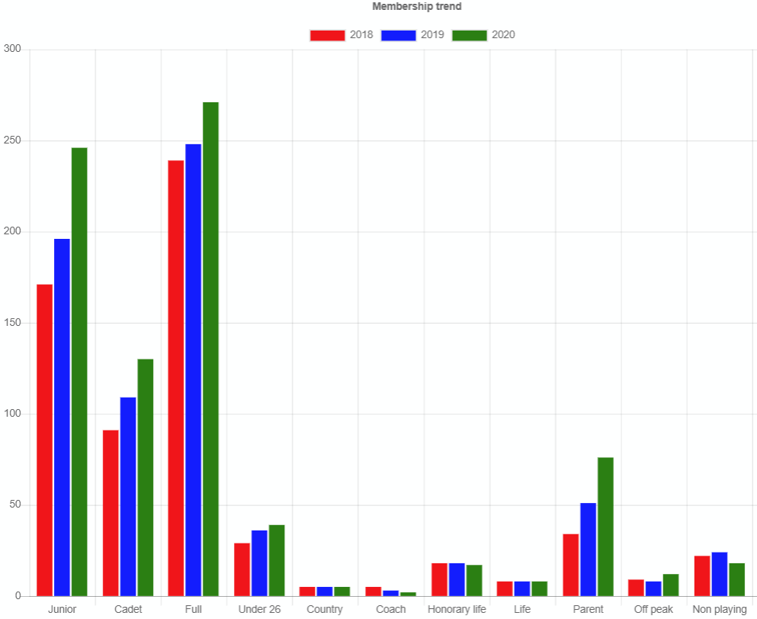
Record membership numbers
Juniors
+25%
Full members
+9%

Slide 5
Honorary Treasurer’s report
Paul Baxter

Slide 6
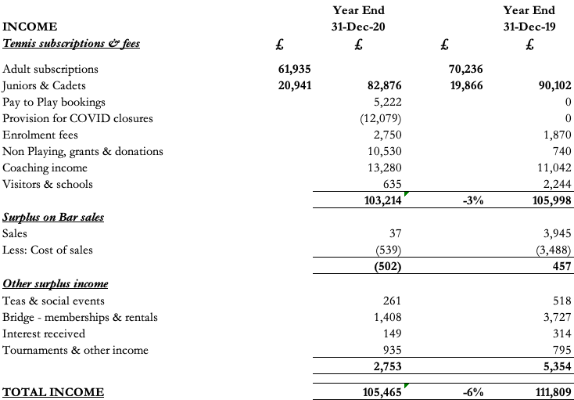
Accounts for the year ended 31 December 2020

Slide 7
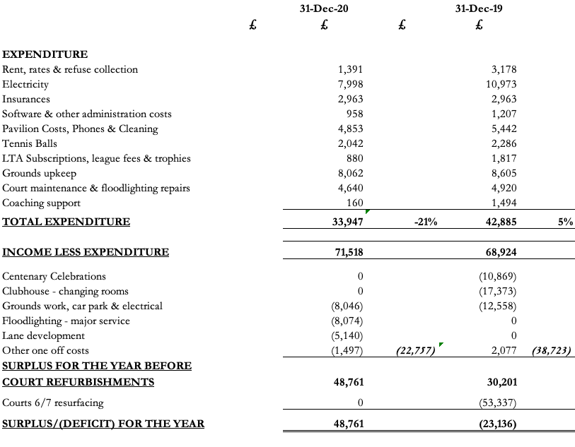
Accounts for the year ended 31 December 2020

Slide 8
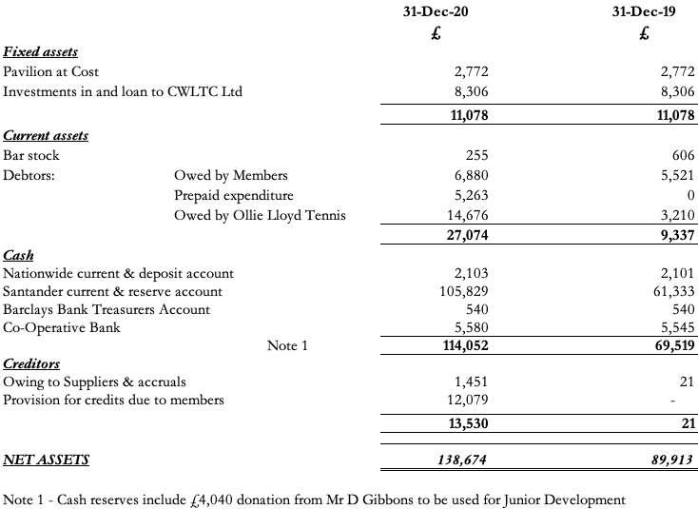
Accounts for the year ended 31 December 2020

Slide 9
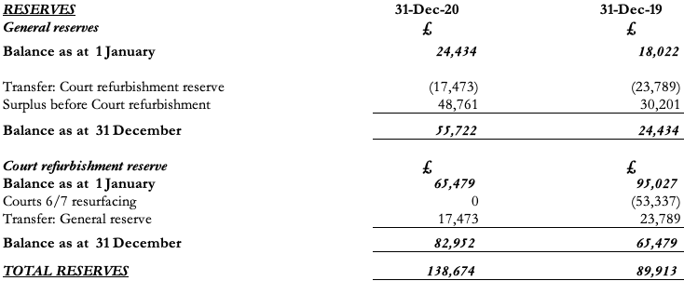
Accounts for the year ended 31 December 2020

Slide 10
Resolution
To adopt the accounts of the Club for the year ended
31 December 2020.

Slide 11
Resolution
To approve the subscriptions and fees for the new membership year.

Slide 12
Subscriptions: 1 May 2021 to 30 April 2020
HELD AT THE SAME LEVEL FOR 3RD YEAR IN A ROW
Full Adult £265
Junior £80
Cadets £36
Under 26 £100
Country & midweek £170
Off peak £170
Parent £80
Non-playing (including Bridge) £30
Joining fee £100
Adult visitor £7
Junior visitor £3

Slide 13
Resolution
To approve the re-election of John Walton as the Club’s Auditor for the coming year.

Slide 14
Resolution
To approve the election of the President, Chair, Honorary Secretary, Honorary Treasurer and other members of the Committee.

Slide 15
Officers and Committee Members
Officers
President: Mike Bourne
Chair: Heather McAtackney
Honorary Secretary: Robert Gale
Honorary Treasurer: Paul Baxter
Management Team
Juniors Secretary: Chris Durkin
Welfare Officer: Val Jermy
Grounds Secretary: Chris Lewis
Match Secretary : Daniel McQue
Social Secretary: Nandini Narayanan
Membership Secretary : Ian Stewart
Other Committee members:
Belinda Grove
Gary Jordan
John Lewis
Meryl Lloyd
Ollie Lloyd
Jan Stewart
Nicki Tattersall

Slide 16
Resolution
To approve the granting of Honorary Life memberships.

Slide 17
Honorary Life Memberships
Membership for over 40 years:
Frances Bance
Sandra Hurl
Willie Nyberg
Roald Pettersen
Wendy Seigel
For exceptional Committee service:
Heather McAtackney

Slide 18
Projects completed in 2020,
Proposed 2021 Expenditure and 5 Year Plan
Rob Gale

Slide 19
Projects completed in 2020
Dealing with consequences of Covid!
IT System developments
  Court booking system
  Integration of coaching course bookings/payments
  Billing complexities: pay-per-play, suspended memberships, credits
  Online tournament software
Safeguarding, Diversity & Inclusion and other policies updated
LTA Safeguarding audit passed
Grounds improvements: Clearance/planting of footpath border
Major floodlight service
Lane development:
  Planning application submitted
  Initial scrub clearance undertaken
  Homeless man’s shelter removed….twice!

Slide 20
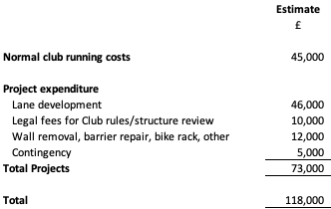
2021 Expenditure Proposal

Slide 21
2021 Expenditure – Lane Development
Project originally approved at 2020 AGM
Lay a footpath running through the woodland area along the length of the lane
Tarmac footpath, width 1.3 metres
New 2m high hedge to form border with Galsworthy Rd to deter access
Low level lighting spaced evenly along the new path
Driven by safety considerations:
Allows members, particularly juniors, to use the lane safely
Pedestrians currently must share the road surface with cars/bikes
Overgrown area provided hiding places for trespassers
Nuisance and danger to members from rough sleeper building shelter in overgrown area

Slide 22
2021 Expenditure – Lane Development
Progress to date:
Project put on hold when Covid closures hit in Spring 2020
Original contractor disappeared
Very late notification from RBK Planning that approval required for footpath
Initial clearance of scrub/brambles undertaken
Planning application, including arboricultural survey report, submitted
Planning approval refused on 25 March 2021
  Biodiversity
  Trees
Propose to engage specialist advice to support appeal of new application
Environmentally friendly footpath surface may be necessary
Many thanks to Bob Blunden for driving the project forward despite unforeseen setbacks!

Slide 23
2021 Expenditure – Lane Development
Project Budget
Approval at 2020 AGM with budget of £31,000
Original contractor no longer available
Additional costs for planning application and arboricultural report
Contingency added to to cover specialist advice fees and possible need for more costly, environmentally friendly path surface
Estimated total project cost £51,000, of which £5,000 incurred in 2020.
Budget for approval in 2021: £46,000

Slide 24
Resolution
To seek approval for proposed 2021 expenditure.

Slide 25
5 Year Plan: Major Projects
2025
Re-surface courts 4 & 5
Terrace improvements
LED floodlights conversion
Update club rules & legal structure
Lane footpath development
Return to normality
2021

Slide 26
Events calendar for 2021
Early May: Club tournament starts
May 17: Bar reopens (subject to Covid roadmap/restrictions/risk assessment)
July 17: “Return to normal” Summer BBQ
September 25: Final’s Day (plus lunch/tea/BBQ)
December 4: Mince pies and mulled wine after social tennis
Other events TBC

Slide 27
Any Other Business

Slide 28
THANK YOU FOR ATTENDING

